Slide 1
Object-Oriented Programming
(OOP)
Lecture No. 5

Slide 2
Access Modifiers
An access modifier restricts the access of a class, constructor, data member and method in another class.
Default
Private
Protected
public

Slide 3
Default access modifier
When we do not mention any access modifier, it is called default access modifier.
The scope of this modifier is limited to the package only. No other class outside this package can access this class.

Slide 4
Default access modifier
To understand Default Access modifier, you must have the knowledge of packages in java.

Slide 5
Packages
A package as the name suggests is a pack(group) of classes, interfaces and other packages. In java we use packages to organize our classes and interfaces.
1) User defined package: The package we create is called user-defined package.
2) Built-in package: The already defined package like java.io.*, java.lang.* etc are known as built-in packages.

Slide 6
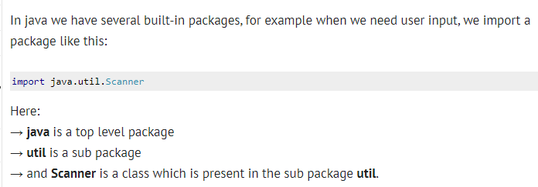
Packages

Slide 7
Private access modifier
The scope of private modifier is limited to the class only.
Private Data members and methods are only accessible within the class
Class and Interface cannot be declared as private
If a class has private constructor then you cannot create the object of that class from outside of the class.

Slide 8
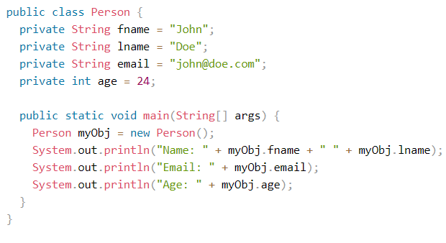
Private access modifier

Slide 9
Protected Access Modifier
Protected data member and method are only accessible by the classes of the same package and the subclasses present in any package. You can also say that the protected access modifier is similar to default access modifier with one exception that it has visibility in sub classes.
Classes cannot be declared protected. This access modifier is generally used in a parent child relationship.

Slide 10
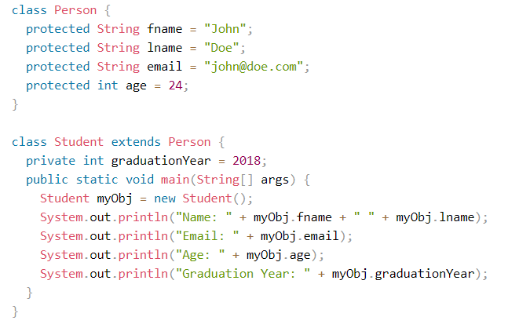
Protected Access Modifier

Slide 11
Public access modifier
The members, methods and classes that are declared public can be accessed from anywhere. This modifier doesn’t put any restriction on the access.

Slide 12
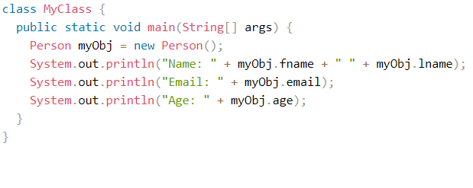
Public access modifier

Slide 13
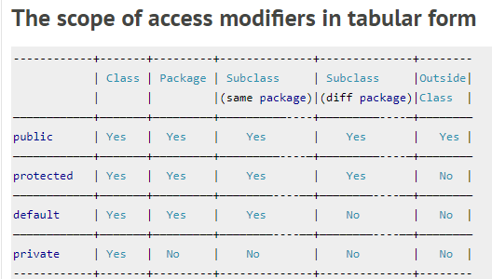

Slide 14
Non-Access Modifiers
Java provides a number of non-access modifiers to achieve many other functionalities.
The static modifier for creating class methods and variables
The final modifier for finalizing the implementations of classes, methods, and variables.
The abstract modifier for creating abstract classes and methods.
The synchronized and volatile modifiers, which are used for threads.

Slide 15
Final Modifier
Final Variable
A final variable can be explicitly initialized only once. A reference variable declared final can never be reassigned to refer to an different object.
However, the data within the object can be changed. So, the state of the object can be changed but not the reference. With variables, the final modifier often is used with static to make the constant a class variable.

Slide 16
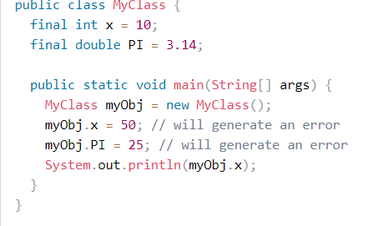
Final Modifier-Variable

Slide 17
Final Modifier-Method
Final Method
A final method cannot be overridden by any subclasses. As mentioned previously, the final modifier prevents a method from being modified in a subclass.
The main intention of making a method final would be that the content of the method should not be changed by any outsider

Slide 18
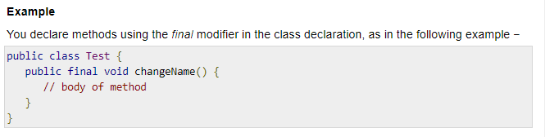
Final Method

Slide 19

Final Modifier-Class
Final Class
The main purpose of using a class being declared as final is to prevent the class from being subclassed. If a class is marked as final then no class can inherit any feature from the final class

Slide 20
Static Modifier
The static keyword is used to create variables that will exist independently of any instances created for the class. Only one copy of the static variable exists regardless of the number of instances of the class.
The static keyword is used to create methods that will exist independently of any instances created for the class.
Static methods do not use any instance variables of any object of the class they are defined in. Static methods take all the data from parameters and compute something from those parameters, with no reference to variables.
Class variables and methods can be accessed using the class name followed by a dot and the name of the variable or method.

Slide 21
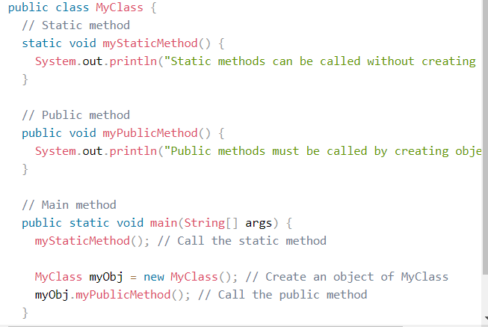
Static Modifier

